Slide 1

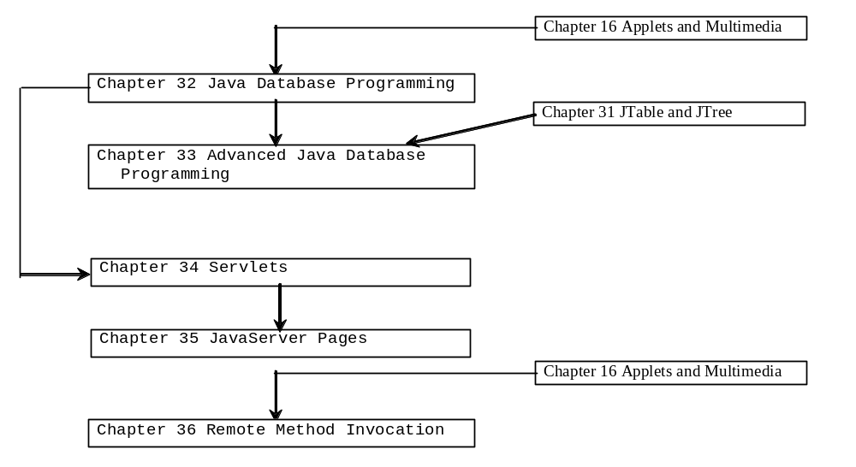
Chapter 35 JavaServer Page

Slide 2
Objectives
To know what is a JSP page is processed (§35.2).
To comprehend how a JSP page is processed (§35.3).
To learn how to use JSP constructs (§35.4).
To become familiar with JSP predefined variables and JSP directives (§35.5-35.6).
To use JavaBeans components in JSP (§35.7-35.9).
To develop database applications using JSP (§35.7-35.9).
To know how to forward requests from JSP (§35.10).

Slide 3
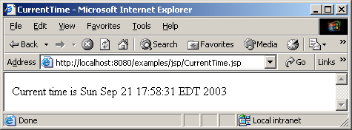
A Simple JSP
<!-- CurrentTime.jsp -->
<HTML>
<HEAD>
<TITLE>
CurrentTime
</TITLE>
</HEAD>
<BODY>
Current time is <%= new java.util.Date() %>
</BODY>
</HTML>

Slide 4
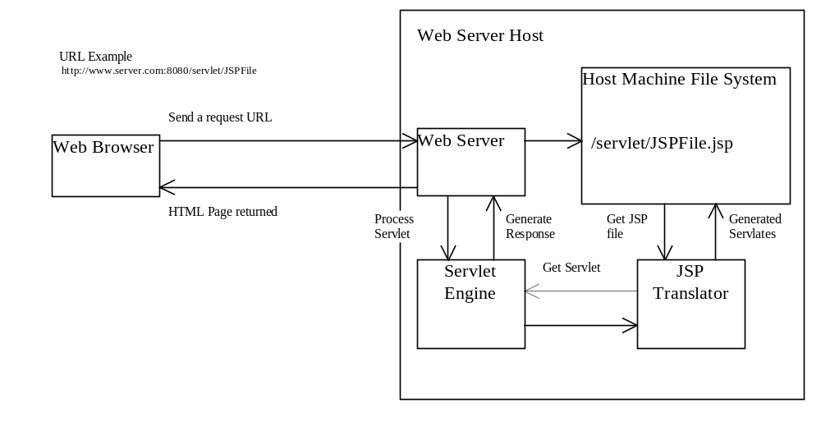
How Is a JSP Processed?

Slide 5
JSP Constructs
There are three types of scripting constructs you can use to insert Java code into the resultant servlet. They are expressions, scriptlets, and declarations.
expression
scriptlet
declaration
A JSP expression is used to insert a Java expression directly into the output. It has the following form:
  <%= Java-expression %>
The expression is evaluated, converted into a
string, and sent to the output stream of the servlet.

Slide 6
JSP Constructs
There are three types of scripting constructs you can use to insert Java code into the resultant servlet. They are expressions, scriptlets, and declarations.
expression
scriptlet
declaration
A JSP scriptlet enables you to insert a Java statement into the servlet’s jspService method, which is invoked by the service method. A JSP scriptlet has the following form:
  <% Java statement %>

Slide 7
JSP Constructs
There are three types of scripting constructs you can use to insert Java code into the resultant servlet. They are expressions, scriptlets, and declarations.
expression
scriptlet
declaration
A JSP declaration is for declaring methods or fields into the servlet. It has the following form:
  <%! Java method or field declaration %>

Slide 8
JSP Comment
HTML comments have the following form:
<!-- HTML Comment -->
If you don’t want the comment appear in the resultant HTML file, use the following comment in JSP:
<%-- JSP Comment --%>

Slide 9
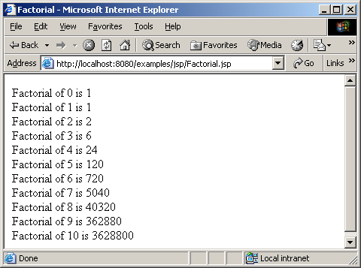
Example 35.1 Computing Factorials
<HTML>
<HEAD>
<TITLE>
Factorial
</TITLE>
</HEAD>
<BODY>
<% for (int i = 0; i <= 10; i++) { %>
Factorial of <%= i %> is
<%= computeFactorial(i) %> <br>
<% } %>
<%! private long computeFactorial(int n) {
if (n == 0)
return 1;
else
return n * computeFactorial(n - 1);
}
%>
</BODY>
</HTML>
JSP scriptlet
JSP expression
JSP declaration

Slide 10
JSP Predefined Variables
You can use variables in JSP. For convenience, JSP provides eight predefined variables from the servlet environment that can be used with JSP expressions and scriptlets. These variables are also known as JSP implicit objects.
request
response
out
session
application
config
pagecontext
page
Represents the client’s request, which is an instance of HttpServletRequest. You can use it to access request parameters, HTTP headers such as cookies, hostname, etc.

Slide 11
JSP Predefined Variables
You can use variables in JSP. For convenience, JSP provides eight predefined variables from the servlet environment that can be used with JSP expressions and scriptlets. These variables are also known as JSP implicit objects.
request
response
out
session
application
config
pagecontext
page
Represents the servlet’s response, which is an instance of HttpServletResponse. You can use it to set response type and send output to the client.

Slide 12
JSP Predefined Variables
You can use variables in JSP. For convenience, JSP provides eight predefined variables from the servlet environment that can be used with JSP expressions and scriptlets. These variables are also known as JSP implicit objects.
request
response
out
session
application
config
pagecontext
page
Represents the character output stream, which is an instance of PrintWriter obtained from response.getWriter(). You can use it to send character content to the client.

Slide 13
JSP Predefined Variables
You can use variables in JSP. For convenience, JSP provides eight predefined variables from the servlet environment that can be used with JSP expressions and scriptlets. These variables are also known as JSP implicit objects.
request
response
out
session
application
config
pagecontext
page
Represents the HttpSession object associated with the request, obtained from request.getSession().

Slide 14
JSP Predefined Variables
You can use variables in JSP. For convenience, JSP provides eight predefined variables from the servlet environment that can be used with JSP expressions and scriptlets. These variables are also known as JSP implicit objects.
request
response
out
session
application
config
pagecontext
page
Represents the ServletContext object for storing persistent data for all clients. The difference between session and application is that session is tied to one client, but application is for all clients to share persistent data.

Slide 15
JSP Predefined Variables
You can use variables in JSP. For convenience, JSP provides eight predefined variables from the servlet environment that can be used with JSP expressions and scriptlets. These variables are also known as JSP implicit objects.
request
response
out
session
application
config
pagecontext
page
Represents the ServletConfig object for the page.

Slide 16
JSP Predefined Variables
You can use variables in JSP. For convenience, JSP provides eight predefined variables from the servlet environment that can be used with JSP expressions and scriptlets. These variables are also known as JSP implicit objects.
request
response
out
session
application
config
pagecontext
page
Represents the PageContext object. PageContext is a new class introduced in JSP to give a central point of access to many page attributes.

Slide 17
JSP Predefined Variables
You can use variables in JSP. For convenience, JSP provides eight predefined variables from the servlet environment that can be used with JSP expressions and scriptlets. These variables are also known as JSP implicit objects.
request
response
out
session
application
config
pagecontext
page
Page is an alternative to this.

Slide 18
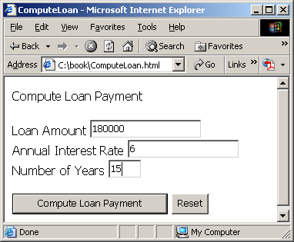
Example 35.2 Computing Loan
<!-- ComputeLoan.html -->
<html>
<head>
<title>ComputeLoan</title>
</head>
<body>
Compute Loan Payment
<form method="get"
action="http://localhost:8080/examples/jsp/ComputeLoan.jsp">
<p>Loan Amount
<input type="text" name="loanAmount"><br>
Annual Interest Rate
<input type="text" name="annualInterestRate"><br>
Number of Years <input type="text" name="numberOfYears" size="3"></p>
<p><input type="submit" name="Submit" value="Compute Loan Payment">
<input type="reset" value="Reset"></p>
</form>
</body>
</html>
Write an HTML page that prompts the user to enter loan amount, annual interest rate, and number of years. Clicking the Compute Loan Payment button invokes a JSP to compute and display the monthly and total loan payment.

Slide 19
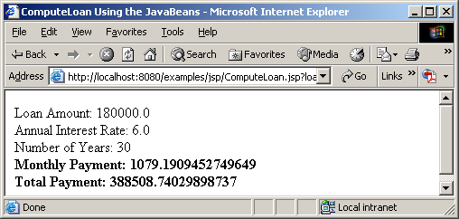
<!-- ComputeLoan.jsp -->
<html>
<head>
<title>ComputeLoan</title>
</head>
<body>
<% double loanAmount = Double.parseDouble(
request.getParameter("loanAmount"));
double annualInterestRate = Double.parseDouble(
request.getParameter("annualInterestRate"));
double numberOfYears = Integer.parseInt(
request.getParameter("numberOfYears"));
double monthlyInterestRate = annualInterestRate / 1200;
double monthlyPayment = loanAmount * monthlyInterestRate /
(1 - 1 / Math.pow(1 + monthlyInterestRate, numberOfYears * 12));
double totalPayment = monthlyPayment * numberOfYears * 12; %>
Loan Amount: <%= loanAmount %><br>
Annual Interest Rate: <%= annualInterestRate %><br>
Number of Years: <%= numberOfYears %><br>
<b>Monthly Payment: <%= monthlyPayment %><br>
Total Payment: <%= totalPayment %><br></b>
</body>
</html>
Predefined variable

Slide 20
JSP Directives
A JSP directive is a statement that gives the JSP engine information about the JSP page. For example, if your JSP page uses a Java class from a package other than the java.lang package, you have to use a directive to import this package. The general syntax for a JSP directive is as follows:
  <%@ directive attribute="value" %>, or
  <%@ directive attribute1="value1"
  attribute2="value2"
  ...
  attributen="vlauen" %>

Slide 21
Three JSP Directives
Three possible directives are the following: page, include, and tablib.
page
include
tablib
page lets you provide information for the page, such as importing classes and setting up content type. The page directive can appear anywhere in the JSP file.

Slide 22
Three JSP Directives
Three possible directives are the following: page, include, and tablib.
page
include
tablib
include lets you insert a file to the servlet when the page is translated to a servlet. The include directive must be placed where you want the file to be inserted.

Slide 23
Three JSP Directives
Three possible directives are the following: page, include, and tablib.
page
include
tablib
tablib lets you define custom tags.

Slide 24
Attributes for page Directives
import
contentType
session
buffer
autoFlush
isThreadSafe
errorPage
isErrorPage
Specifies one or more packages to be imported for this page. For example, the directive <%@ page import="java.util.*, java.text.*" %> imports java.util.* and java.text.*.

Slide 25
Attributes for page Directives
import
contentType
session
buffer
autoFlush
isThreadSafe
errorPage
isErrorPage
Specifies the MIME type for the resultant JSP page. By default, the content type is text/html for JSP. The default content type for servlets is text/plain.

Slide 26
Attributes for page Directives
import
contentType
session
buffer
autoFlush
isThreadSafe
errorPage
isErrorPage
Specifies a boolean value to indicate whether the page is part of the session. By default, session is true.

Slide 27
Attributes for page Directives
import
contentType
session
buffer
autoFlush
isThreadSafe
errorPage
isErrorPage
Specifies the output stream buffer size. By default, it is 8KB. For example, the directive <%@ page buffer="10KB" %> specifies that the output buffer size is 10KB. The directive <%@ page buffer="none" %> specifies that a buffer is not used.

Slide 28
Attributes for page Directives
import
contentType
session
buffer
autoFlush
isThreadSafe
errorPage
isErrorPage
Specifies a boolean value to indicate whether the output buffer should be automatically flushed when it is full or whether an exception should be raised when the buffer overflows. By default, this attribute is true. In this case, the buffer attribute cannot be none.

Slide 29
Attributes for page Directives
import
contentType
session
buffer
autoFlush
isThreadSafe
errorPage
isErrorPage
Specifies a boolean value to indicate whether the page can be accessed simultaneously without data corruption. By default, it is true. If it is set to false, the JSP page will be translated to a servlet that implements the SingleThreadModel interface.

Slide 30
Attributes for page Directives
import
contentType
session
buffer
autoFlush
isThreadSafe
errorPage
isErrorPage
errorPage specifies a JSP page that is processed when an exception occurs in the current page. For example, the directive <%@ page errorPage="HandleError.jsp" %> specifies that HandleError.jsp is processed when an exception occurs.
• isErrorPage specifies a boolean value to indicate whether the page can be used as an error page. By default, this attribute is false.

Slide 31
Example: Computing Loan Using the Loan Class
<!-- ComputeLoan.jsp -->
<html>
<head>
<title>ComputeLoan Using the Loan Class</title>
</head>
<body>
<%@ page import = "chapter35.Loan" %>
<% double loanAmount = Double.parseDouble(
request.getParameter("loanAmount"));
double annualInterestRate = Double.parseDouble(
request.getParameter("annualInterestRate"));
int numberOfYears = Integer.parseInt(
request.getParameter("numberOfYears"));
Loan loan = new Loan(annualInterestRate, numberOfYears, loanAmount);
%>
Loan Amount: <%= loanAmount %><br>
Annual Interest Rate: <%= annualInterestRate %><br>
Number of Years: <%= numberOfYears %><br>
<b>Monthly Payment: <%= loan.monthlyPayment() %><br>
Total Payment: <%= loan.totalPayment() %><br></b>
</body>
</html>
Use the Loan class to simplify Example 35.2. You can create an object of Loan class and use its monthlyPayment() and totalPayment() methods to compute the monthly payment and total payment.
Import a class. The class must be placed in a package (e.g. package chapter35.

Slide 32
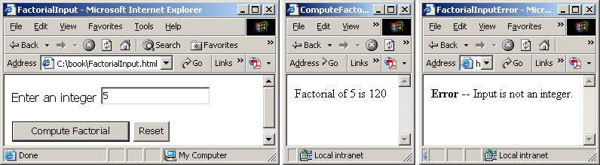
Example: Using Error Pages
This example prompts the user to enter an integer and displays the factorial for the integer. If a noninteger value is entered by mistake, an error page is displayed.

Slide 33
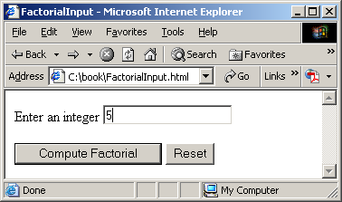
<!-- FactorialInput.html -->
<HTML>
<HEAD>
<TITLE>
FactorialInput
</TITLE>
</HEAD>
<BODY>
<FORM method="post"
action="http://localhost:8080/examples/jsp/ComputeFactorial.jsp">
Enter an integer <INPUT NAME="number"><BR><BR>
<INPUT TYPE="SUBMIT" NAME="Submit" VALUE="Compute Factorial">
<INPUT TYPE="RESET" VALUE="Reset">
</FORM>
</BODY>
</HTML>

Slide 34
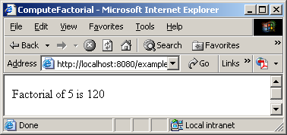
<!-- ComputeFactorial.jsp -->
<HTML>
<HEAD>
<TITLE>
ComputeFactorial
</TITLE>
</HEAD>
<BODY>
<%@ page import ="java.text.*" %>
<%@ page errorPage = "FactorialInputError.jsp" %>
<% NumberFormat format = NumberFormat.getNumberInstance();
int number = Integer.parseInt(request.getParameter("number")); %>
Factorial of <%= number %> is
<%= format.format(computeFactorial(number)) %> <p>
<%! private long computeFactorial(int n) {
if (n == 0)
return 1;
else
return n * computeFactorial(n - 1);
}
%>
</BODY>
</HTML>
Error page

Slide 35
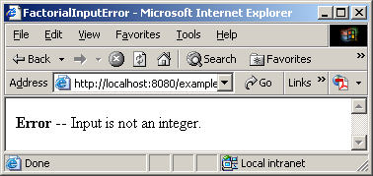
<!-- FactorialInputError.jsp -->
<HTML>
<HEAD>
<TITLE>
FactorialInputError
</TITLE>
</HEAD>
<BODY>
<%@ page isErrorPage = "true" %>
<b>Error</b> -- Input is not an integer.
</BODY>
</HTML>
Indicate it is error page

Slide 36
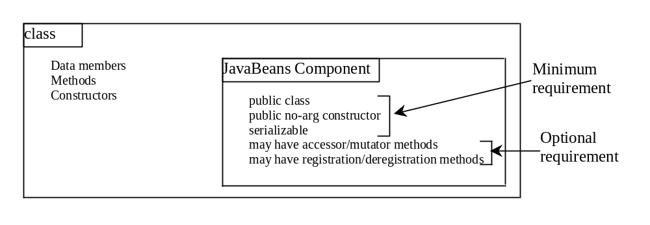
What is JavaBean?
A JavaBeans component is a serializable public class with a public no-arg constructor.
Every GUI class is a JavaBeans component, because (1) it is a public class; (2) it has a public no-arg constructor; (3) It is an extension of java.awt.Component, which implements java.io.Serializable.

Slide 37
Why JavaBeans?
The JavaBeans technology was developed to enable the programmers to rapidly build applications by assembling objects and test them during design time, thus making reuse of the software more productive.
JavaBeans is a software component architecture that extends the power of the Java language by enabling well-formed objects to be manipulated visually at design time in a pure Java builder tool, such as JBuilder and NetBeans.

Slide 38
JavaBeans Properties and Naming Patterns
The get method is named
  get<PropertyName>(),
which takes no parameters and returns an object of the type identical to the property type.
For a property of boolean type, the get method should be named
  is<PropertyName>(),
which returns a boolean value.
The set method should be named
  set<PropertyName>(newValue),
which takes a single parameter identical to the property type and returns void.

Slide 39
Properties and Data Fields
Properties describe the state of the bean. Naturally, data fields are used to store properties. However, a bean property is not necessarily a data field. For example, in the MessagePanel class in Example 12.5 in Chapter 13, you may create a new property named messageLength that represents the number of the characters in message. The get method for the property may be defined as follows:
  public int getMessageLength() {
  return message.length();
  }
NOTE: A property may be read-only with a get method but no set method, or write-only with a set method but no get method.

Slide 40
package chapter35; //
public class Student {
private String firstName;
private String mi;
private String lastName;
private String telephone;
private String street;
private String city;
private String state;
private String email;
private String zip;
public String getFirstName() {
return this.firstName;
}
public void setFirstName(String firstName) {
this.firstName = firstName;
}
public String getMi() {
return this.mi;
}
public void setMi(String mi) {
this.mi = mi;
}

Slide 41
public String getLastName() {
return this.lastName;
}
public void setLastName(String lastName) {
this.lastName = lastName;
}
public String getTelephone() {
return this.telephone;
}
public void setTelephone(String telephone) {
this.telephone = telephone;
}
public String getEmail() {
return this.email;
}
public void setEmail(String email) {
this.email = email;
}
public String getStreet() {
return this.street;
}
public void setStreet(String street) {
this.street = street;
}

Slide 42
public String getCity() {
return this.city;
}
public void setCity(String city) {
this.city = city;
}
public String getState() {
return this.state;
}
public void setState(String state) {
this.state = state;
}
public String getZip() {
return this.zip;
}
public void setZip(String zip) {
this.zip = zip;
}
}

Slide 43
Using JavaBeans in JSP
To create an instance for a JavaBeans component, use the following syntax:
  <jsp:useBean id="objectName" scope="scopeAttribute“ class="ClassName" />
This syntax is equivalent to
  <% ClassName objectName = new ClassName() %>
except that the scope attribute specifies the scope of the object.

Slide 44
Scope Attributes
application
session
page
request
Specifies that the object is bound to the application. The object can be shared by all sessions of the application.

Slide 45
Scope Attributes
application
session
page
request
Specifies that the object is bound to the client’s session. Recall that a client’s session is automatically created between a Web browser and Web server. When a client from the same browser accesses two servlets or two JSP pages on the same server, the session is the same.

Slide 46
Scope Attributes
application
session
page
request
The default scope, which specifies that the object is bound to the page.

Slide 47
Scope Attributes
application
session
page
request
Specifies that the object is bound to the client’s request.

Slide 48
How Does JSP Find an Object
When <jsp:useBean id="objectName" scope="scopeAttribute" class="ClassName" /> is processed, the JSP engine first searches for the object of the class with the same id and scope. If found, the preexisting bean is used; otherwise, a new bean is created.

Slide 49
Another Syntax for Creating a Bean
Here is another syntax for creating a bean using the following statement:
  <jsp:useBean id="objectName" scope="scopeAttribute“ class="ClassName" >
  some statements
  </jsp:useBean>
The statements are executed when the bean is created. If the bean with the same id and className already exists, the statements are not executed.

Slide 50
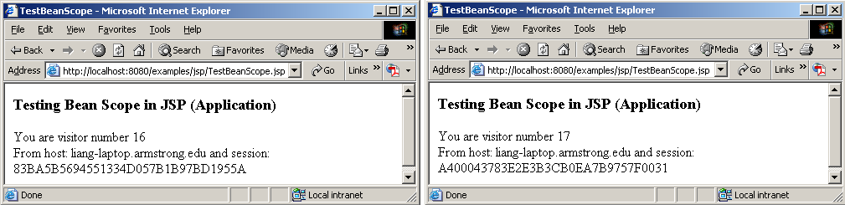
Example: Testing Bean Scope
This example creates a JavaBeans component named Count and uses it to count the number of visits to a page.

Slide 51
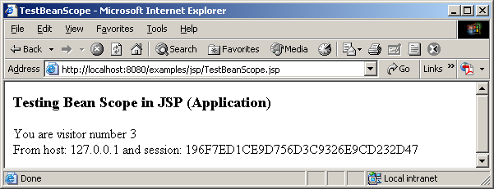
<!-- TestBeanScope.jsp -->
<%@ page import = "chapter35.Count" %>
<jsp:useBean id="count" scope="application" class="chapter35.Count">
</jsp:useBean>
<HTML>
<HEAD>
<TITLE>TestBeanScope</TITLE>
</HEAD>
<BODY>
<H3>
Testing Bean Scope in JSP (Application)
</H3>
<% count.increaseCount(); %>
You are visitor number <%= count.getCount() %><br>
From host: <%= request.getRemoteHost() %>
and session: <%= session.getId() %>
</BODY>
</HTML>
package chapter27;
public class Count {
private int count = 0;
/** Return count property */
public int getCount() {
return count;
}
/** Increase count */
public void increaseCount() {
count++;
}
}

Slide 52
Getting and Setting Properties
By convention, A JavaBeans component provides the get and set methods for reading and modifying its private properties. You can get the property in JSP using the following syntax:
  <jsp:getProperty name="beanId“ property="sample" />
This is equivalent to
  <%= beanId.getSample() %>

Slide 53
Getting and Setting Properties, cont.
You can set the property in JSP using the following syntax:
  <jsp:setProperty name="beanId“ property="sample“ value="test1" />
This is equivalent to
  <% beanId.setSample("test1"); %>

Slide 54
Associating Properties with Input Parameters
Often properties are associated with input parameters. Suppose you want to get the value of the input parameter named score and set it to the JavaBeans property named score. You may write the following code:
<% double score = Double.parseDouble(
request.getParameter("score")); %>
<jsp:setProperty name="beanId" property="score"
value="<%= score %>" />

Slide 55
Associating Properties with Input Parameters, cont.
This is cumbersome. JSP provides a convenient syntax that can be used to simplify it as follows:
<jsp:setProperty name="beanId" property="score"
param="score" />
Instead of using the value attribute, you use the param attribute to name an input parameter. The value of this parameter is set to the property.

Slide 56
Associating All Properties
Often the bean property and the parameter have the same name. You can use the following convenient statement to associate all the bean properties in beanId with the parameters that match the property names.
<jsp:setProperty name="beanId" property="*" />

Slide 57
Example: Computing Loan Using JavaBeans
Use JavaBeans to simplify Example 35.3 by associating the bean properties with the input parameters.
<!-- ComputeLoan.jsp -->
<html>
<head>
<title>ComputeLoan Using the Loan Class</title>
</head>
<body>
<%@ page import = "chapter35.Loan" %>
<jsp:useBean id="loan" class="chapter35.Loan"></jsp:useBean>
<jsp:setProperty name="loan" property="*" />
Loan Amount: <%= loan.getLoanAmount() %><br>
Annual Interest Rate: <%= loan.getAnnualInterestRate() %><br>
Number of Years: <%= loan.getNumOfYears() %><br>
<b>Monthly Payment: <%= loan.monthlyPayment() %><br>
Total Payment: <%= loan.totalPayment() %><br></b>
</body>
</html>
Associating the bean properties with the input parameters.
Getting

Slide 58
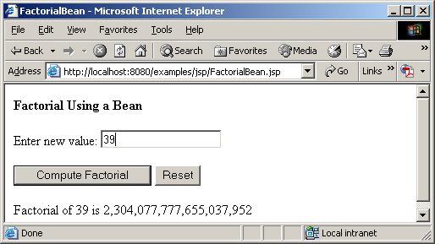
Example: Computing Factorials Using JavaBeans
Create a JavaBeans component named FactorialBean and use it to compute the factorial of an input number in a JSP page named FactorialBean.jsp.

Slide 59
<!-- FactorialBean.jsp -->
<%@ page import = "chapter35.FactorialBean" %>
<jsp:useBean id="factorialBeanId" class="chapter35.FactorialBean" >
</jsp:useBean>
<jsp:setProperty name="factorialBeanId" property="*" />
<HTML>
<HEAD>
<TITLE>
FactorialBean
</TITLE>
</HEAD>
<BODY>
<H3>
Compute Factorial Using a Bean
</H3>
<FORM method="post">
Enter new value: <INPUT NAME="number"><BR><BR>
<INPUT TYPE="SUBMIT" NAME="Submit" VALUE="Compute Factorial">
<INPUT TYPE="RESET" VALUE="Reset">
<P>Factorial of
<jsp:getProperty name="factorialBeanId" property="number" /> is
<%@ page import="java.text.*" %>
<% NumberFormat format = NumberFormat.getNumberInstance(); %>
<%= format.format(factorialBeanId.getFactorial()) %>
</FORM>
</BODY>
</HTML>
Associating the bean properties with the input parameters.
Getting
Getting number

Slide 60
package chatper35;
public class FactorialBean {
private int number;
/** Return number property */
public int getNumber() {
return number;
}
/** Set number property */
public void setNumber(int newValue) {
number = newValue;
}
/** Obtain factorial */
public long getFactorial() {
long factorial = 1;
for (int i = 1; i <= number; i++)
factorial *= i;
return factorial;
}
}
Getting

Slide 61
Forwarding Requests from JavaServer Pages
Web applications developed using JSP generally consist of many pages linked together. JSP provides a forwarding tag in the following syntax that can be used to forward a page to another page.
  <jsp:forward page="destination" />

Slide 62
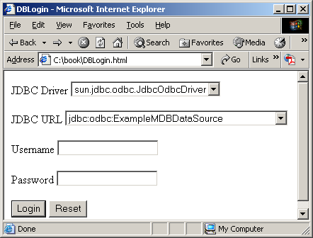
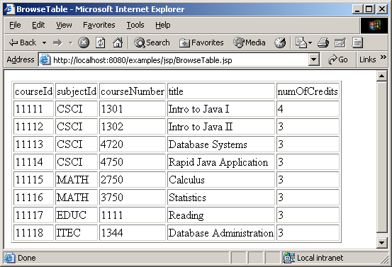
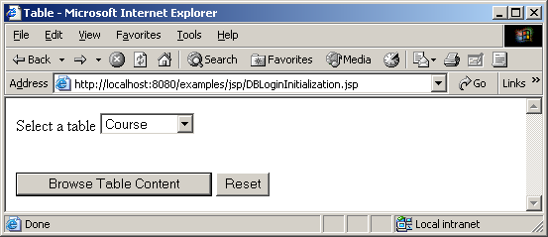
Example: Browsing Database Tables
This example creates a JSP database application that browses tables. When you start the application, the first page prompts the user to enter the JDBC driver, URL, username, and password for a database. After you login to the database, you can select a table to browse. Upon clicking the Browse Table Content button, the table content is displayed.

